Slide 1

Model Writer
Work Package 1 - Industrial Use Cases and Requirements
Integration with Application Lifecycle Management tools
Eray TÜZÜN (HAVELSAN )
Yagup MACİT (HAVELSAN)

Slide 2
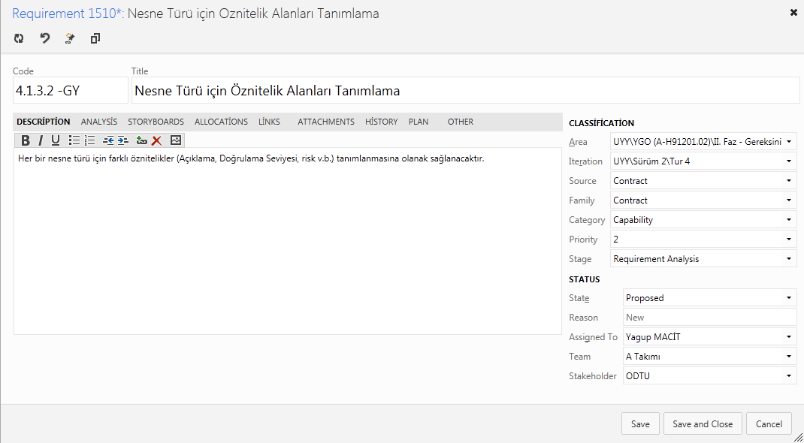
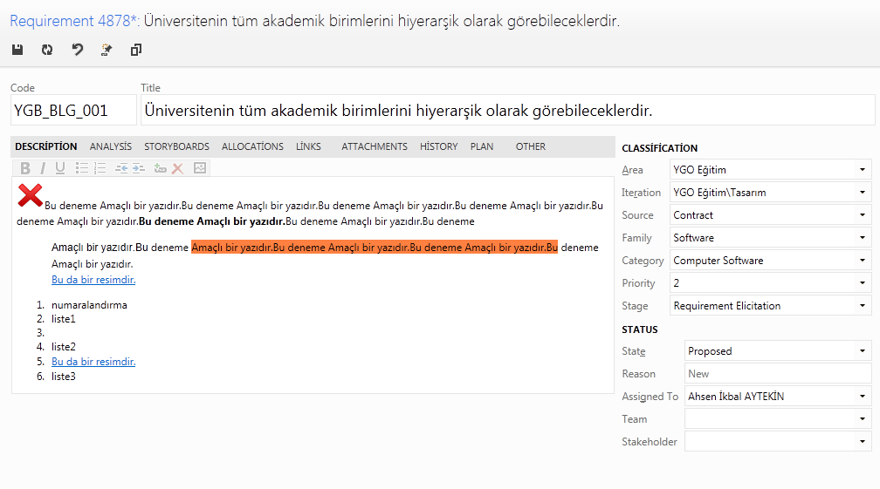
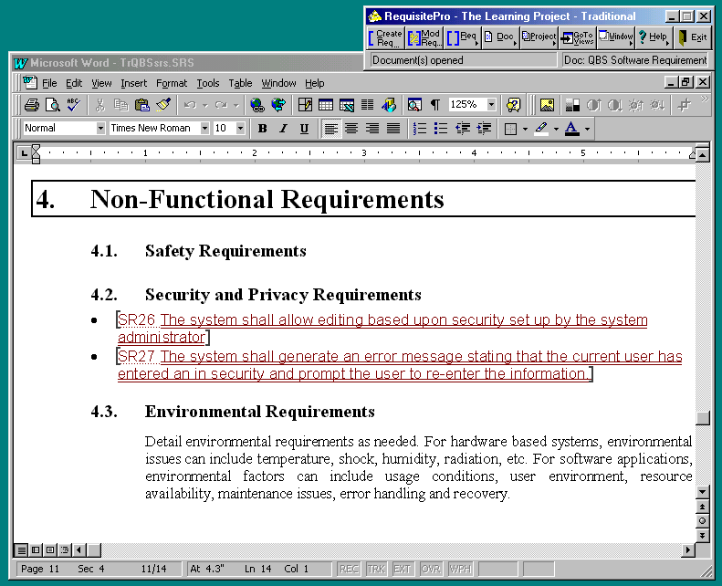
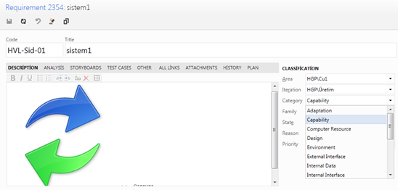
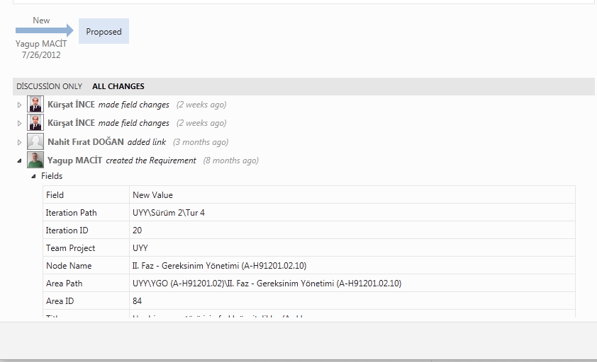
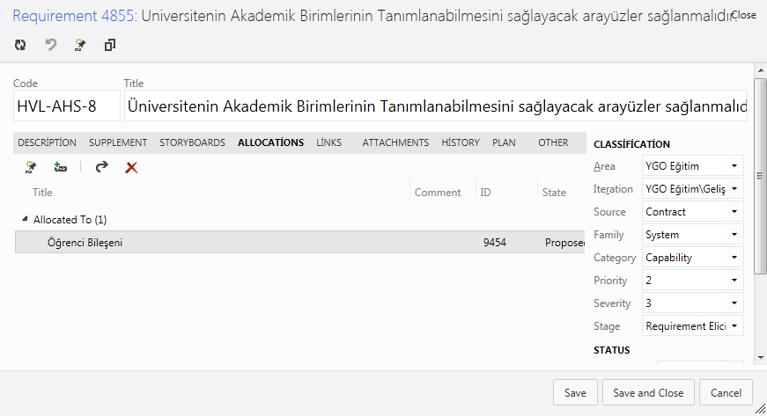
Requirement Work Item
Customized Form
Attributes
WorkItem Number Patterns
History
Discussion

Slide 3
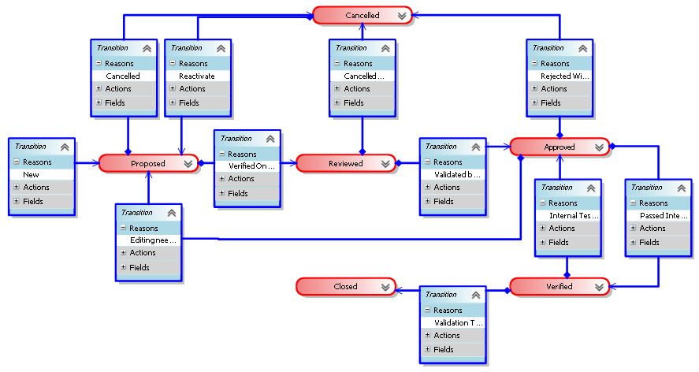
Requirement LifeCycle
Notes:
We defined a structured requirement object as an entity, that have a set of lifecycle states, defined transitions between these states, history of changes, related attributes (unique id, priority, severity, validation method etc.), and traceability information to various project artefacts such as other requirements, design model, source code, bugs, test cases etc.

Slide 4
Requirements Traceability

Slide 5
Requirements in ALM

Slide 6
Requirements in ALM
Traceability with other artifacts is key
Requirements to other requirements
Customer/System/Software/Hardware..
Dependency relation between requirements
Requirements to tasks (Project management)
Requirements to Test Cases
Requirements to Design elements
Requirements to generated documents
Requirements to source code
Requirements to Build
Requirements to bugs
Requirements to risks
…
Notes:
Requirements Engineering is not a separate activity. It is part of ALM. Requirements as a document or a separate entity does not mean anything.
A lot of the big software development companies have made a lot of investments to build an integrated ALM platform which would cover the entire lifecycle of an application.
This Use Case aims at integrating ModelWriter with requirements management portion of the Application Lifecycle Management (ALM) tools. In a typical ALM platform, “requirement” is represented as a structured requirement object rather than text.

Slide 7
HAVELSAN Use case for ModelWriter
Currently we support scenario #1 and #4, and interested in Scenario #3, #2

Slide 8
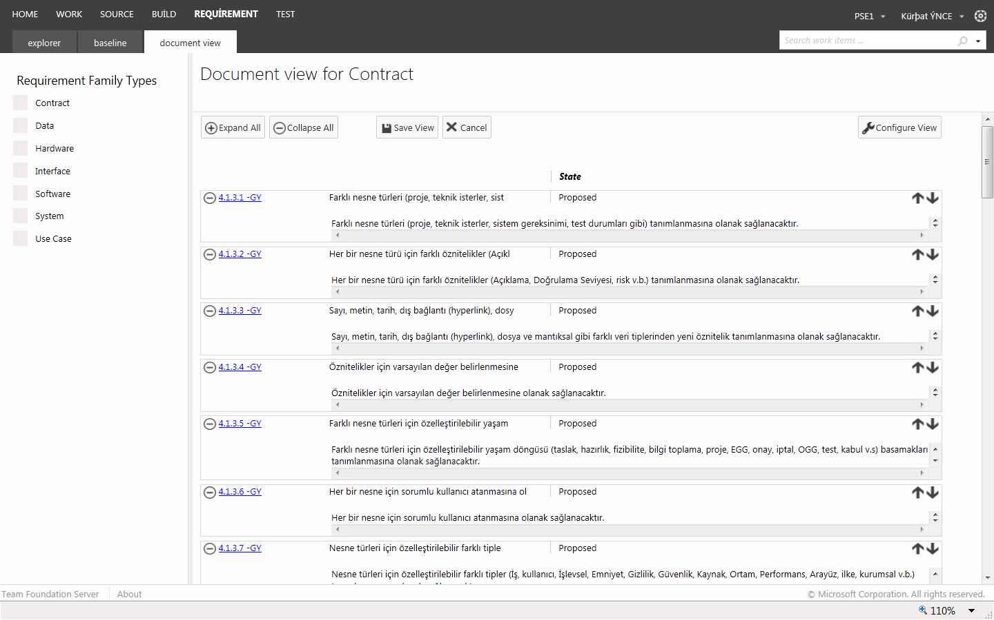
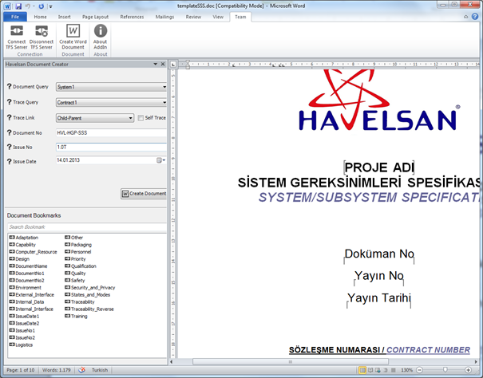
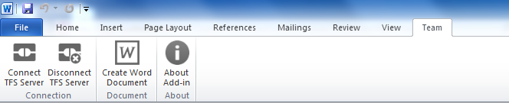
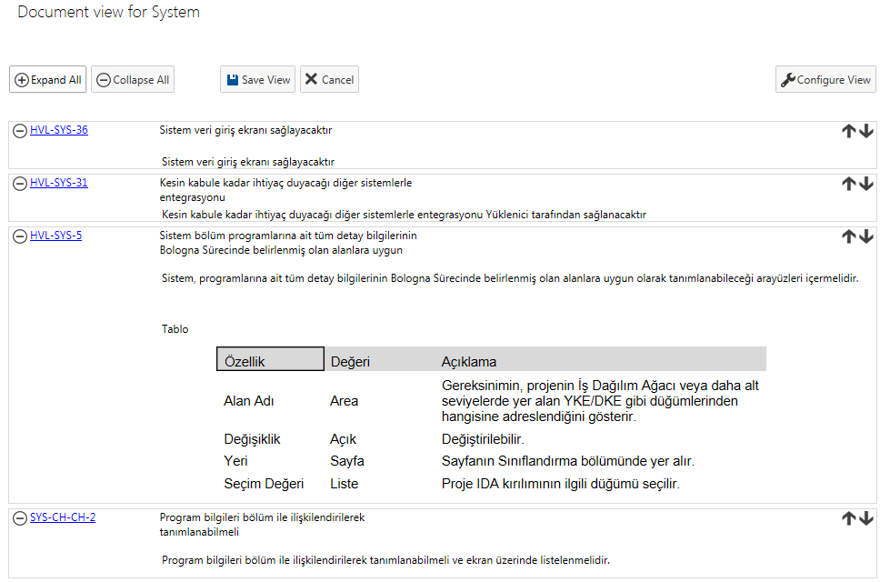
Havelsan Ext - Document Generation
Preview
Word Extension
Support for Templates

Slide 9
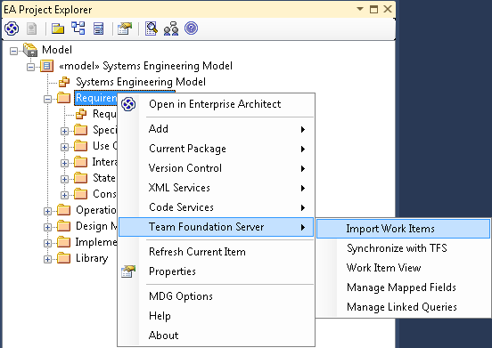
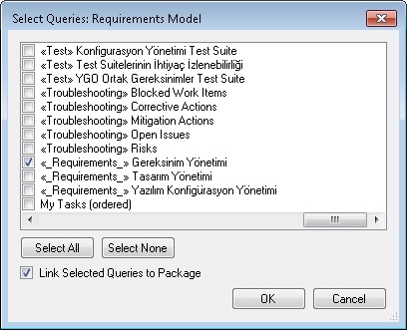
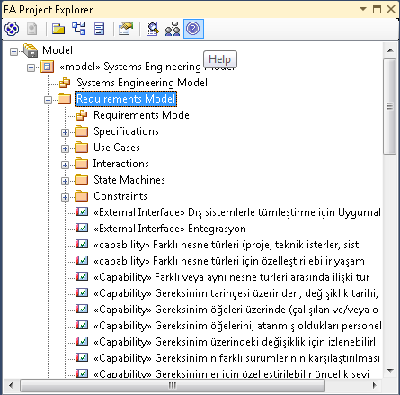
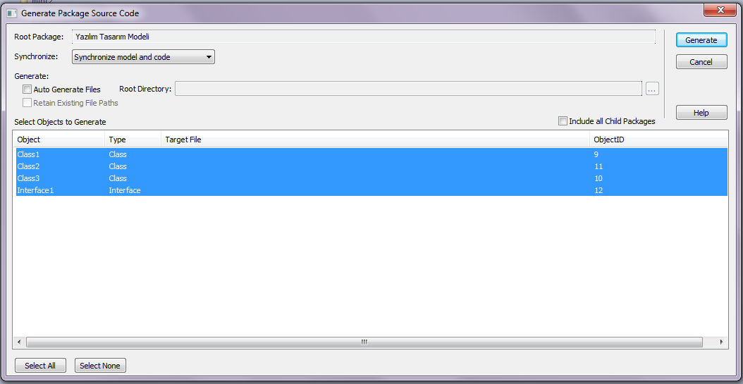
Requirements - Design Model Traceability
Requirements would be imported to the Design tool for traceability.
Code generation from design

